Slide 1
Consumers, Producers,
and the Efficiency of Markets
© 2015 Cengage Learning. All Rights Reserved. May not be copied, scanned, or duplicated, in whole or in part, except for use as permitted in a license distributed with a certain product or service or otherwise on a password-protected website for classroom use.

Slide 2
Consumer Surplus
Welfare economics
  The study of how the allocation of resources affects economic well-being
    Benefits that buyers and sellers receive from engaging in market transactions
    How society can make these benefits as large as possible
    In any market, the equilibrium of supply and demand maximizes the total benefits received by all buyers and sellers combined
© 2015 Cengage Learning. All Rights Reserved. May not be copied, scanned, or duplicated, in whole or in part, except for use as permitted in a license distributed with a certain product or service or otherwise on a password-protected website for classroom use.

Slide 3
Consumer Surplus
Willingness to pay
  Maximum amount that a buyer will pay for a good
  How much that buyer values the good
Consumer surplus
  Amount a buyer is willing to pay for a good minus amount the buyer actually pays for it
  Willingness to pay minus price paid
© 2015 Cengage Learning. All Rights Reserved. May not be copied, scanned, or duplicated, in whole or in part, except for use as permitted in a license distributed with a certain product or service or otherwise on a password-protected website for classroom use.

Slide 4
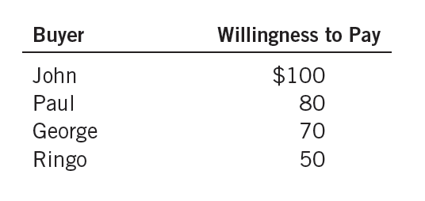
Table 1
Four Possible Buyers’ Willingness to Pay
© 2015 Cengage Learning. All Rights Reserved. May not be copied, scanned, or duplicated, in whole or in part, except for use as permitted in a license distributed with a certain product or service or otherwise on a password-protected website for classroom use.

Slide 5
Consumer Surplus
Consumer surplus
  Measures the benefit buyers receive from participating in a market
  Closely related to the demand curve
Demand schedule
  Derived from the willingness to pay of the possible buyers
© 2015 Cengage Learning. All Rights Reserved. May not be copied, scanned, or duplicated, in whole or in part, except for use as permitted in a license distributed with a certain product or service or otherwise on a password-protected website for classroom use.

Slide 6

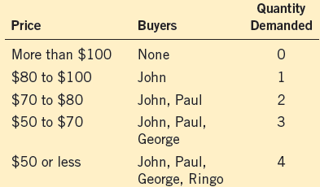



Figure 1
The Demand Schedule and the Demand Curve
Price of Albums
Demand
$100
80
70
50
0
1
2
3
4
Quantity of Albums
The table shows the demand schedule for the buyers (listed in Table 1) of the mint-condition copy of Elvis Presley’s first album. The graph shows the corresponding demand curve. Note that the height of the demand curve reflects the buyers’ willingness to pay.
© 2015 Cengage Learning. All Rights Reserved. May not be copied, scanned, or duplicated, in whole or in part, except for use as permitted in a license distributed with a certain product or service or otherwise on a password-protected website for classroom use.

Slide 7
Consumer Surplus
At any quantity, the price given by the demand curve
  Shows the willingness to pay of the marginal buyer
    The buyer who would leave the market first if the price were any higher
Consumer surplus in a market
  Area below the demand curve and above the price
© 2015 Cengage Learning. All Rights Reserved. May not be copied, scanned, or duplicated, in whole or in part, except for use as permitted in a license distributed with a certain product or service or otherwise on a password-protected website for classroom use.

Slide 8
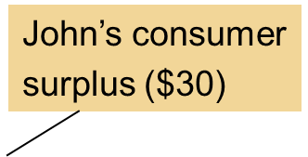
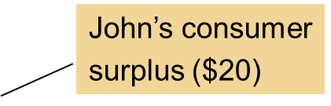
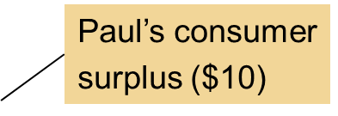
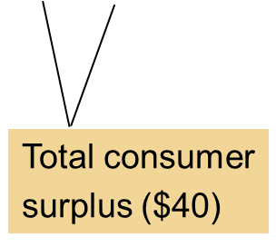
Figure 2
Measuring Consumer Surplus with the Demand Curve
(a) Price = $80
(b) Price = $70
Price of
Albums
Price of
Albums
$100
$100
80
80
70
70
50
50
Demand
Demand
0
1
2
3
4
0
1
2
3
4
Quantity of Albums
Quantity of Albums
In panel (a), the price of the good is $80 and the consumer surplus is $20. In panel (b), the price of the good is $70 and the consumer surplus is $40.
© 2015 Cengage Learning. All Rights Reserved. May not be copied, scanned, or duplicated, in whole or in part, except for use as permitted in a license distributed with a certain product or service or otherwise on a password-protected website for classroom use.

Slide 9
Consumer Surplus
A lower price raises consumer surplus
  Existing buyers: increase in consumer surplus
    Buyers who were already buying the good at the higher price are better off because they now pay less
  New buyers enter the market: increase in consumer surplus
    Willing to buy the good at the lower price
© 2015 Cengage Learning. All Rights Reserved. May not be copied, scanned, or duplicated, in whole or in part, except for use as permitted in a license distributed with a certain product or service or otherwise on a password-protected website for classroom use.

Slide 10
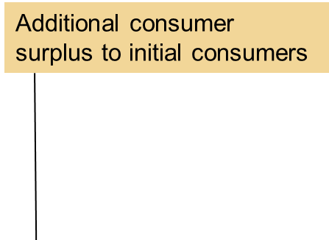
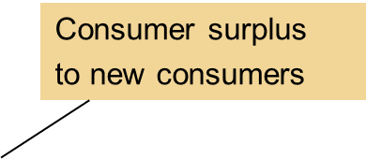
Figure 3
How Price Affects Consumer Surplus
(a) Consumer Surplus at Price P₁
(b) Consumer Surplus at Price P₂
Price
Price
A
A
Initial
consumer
surplus
Consumer
surplus
C
C
P₁
P₁
B
B
F
P₂
Demand
D
E
Demand
0
Q₁
Quantity
0
Q₁
Q₂
Quantity
In panel (a), the price is P₁, the quantity demanded is Q₁, and consumer surplus equals the area of the triangle ABC. When the price falls from P₁ to P₂, as in panel (b), the quantity demanded rises from Q₁ to Q₂, and the consumer surplus rises to the area of the triangle ADF. The increase in consumer surplus (area BCFD) occurs in part because existing consumers now pay less (area BCED) and in part because new consumers enter the market at the lower price (area CEF).
© 2015 Cengage Learning. All Rights Reserved. May not be copied, scanned, or duplicated, in whole or in part, except for use as permitted in a license distributed with a certain product or service or otherwise on a password-protected website for classroom use.

Slide 11
Consumer Surplus
Consumer surplus
  Benefit that buyers receive from a good
    As the buyers themselves perceive it
  Good measure of economic well-being
  Exception: illegal drugs
    Drug addicts are willing to pay a high price for heroin
    Society’s standpoint
      Drug addicts don’t get a large benefit from being able to buy heroin at a low price
© 2015 Cengage Learning. All Rights Reserved. May not be copied, scanned, or duplicated, in whole or in part, except for use as permitted in a license distributed with a certain product or service or otherwise on a password-protected website for classroom use.

Slide 12
Producer Surplus
Cost
  Value of everything a seller must give up to produce a good
  Measure of willingness to sell
Producer surplus
  Amount a seller is paid for a good minus the seller’s cost of providing it
  Price received minus willingness to sell
© 2015 Cengage Learning. All Rights Reserved. May not be copied, scanned, or duplicated, in whole or in part, except for use as permitted in a license distributed with a certain product or service or otherwise on a password-protected website for classroom use.

Slide 13
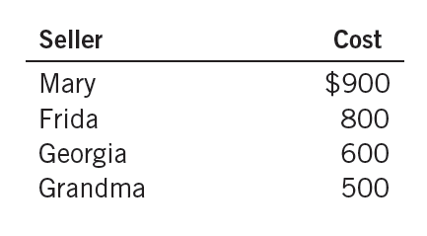
Table 2
The Costs of Four Possible Sellers
© 2015 Cengage Learning. All Rights Reserved. May not be copied, scanned, or duplicated, in whole or in part, except for use as permitted in a license distributed with a certain product or service or otherwise on a password-protected website for classroom use.

Slide 14
Producer Surplus
Producer surplus
  Closely related to the supply curve
Supply schedule
  Derived from the costs of the suppliers
At any quantity
  Price given by the supply curve shows the cost of the marginal seller
    Seller who would leave the market first if the price were any lower
© 2015 Cengage Learning. All Rights Reserved. May not be copied, scanned, or duplicated, in whole or in part, except for use as permitted in a license distributed with a certain product or service or otherwise on a password-protected website for classroom use.

Slide 15

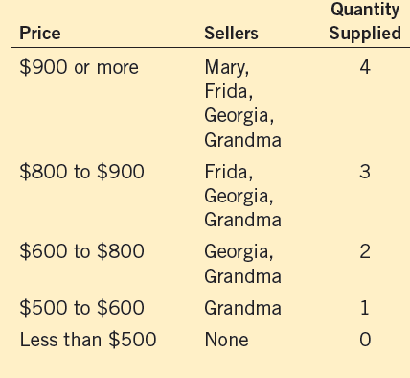



Figure 4
The Supply Schedule and the Supply Curve
Price of House Painting
Supply
$900
800
600
500
0
1
2
3
4
Quantity of Houses Painted
The table shows the supply schedule for the sellers in Table 2. The graph shows the corresponding supply curve. Note that the height of the supply curve reflects sellers’ costs.
© 2015 Cengage Learning. All Rights Reserved. May not be copied, scanned, or duplicated, in whole or in part, except for use as permitted in a license distributed with a certain product or service or otherwise on a password-protected website for classroom use.

Slide 16
Producer Surplus
Supply curve
  Reflects sellers’ costs
  Used to measure producer surplus
Producer surplus in a market
  Area below the price and above the supply curve
© 2015 Cengage Learning. All Rights Reserved. May not be copied, scanned, or duplicated, in whole or in part, except for use as permitted in a license distributed with a certain product or service or otherwise on a password-protected website for classroom use.

Slide 17
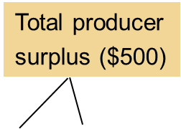
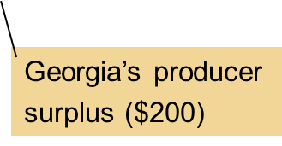
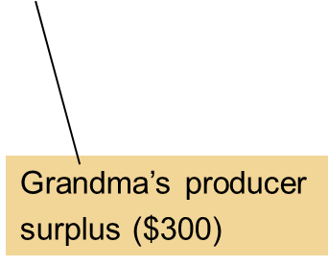
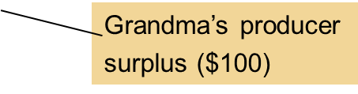
Figure 5
Measuring Producer Surplus with the Supply Curve
(a) Price = $600
(b) Price = $800
Price of House Painting
Price of House Painting
Supply
Supply
$900
$900
800
800
600
600
500
500
0
1
2
3
4
0
1
2
3
4
Quantity of Houses Painted
Quantity of Houses Painted
In panel (a), the price of the good is $600, and the producer surplus is $100. In panel (b), the price of the good is $800, and the producer surplus is $500.
© 2015 Cengage Learning. All Rights Reserved. May not be copied, scanned, or duplicated, in whole or in part, except for use as permitted in a license distributed with a certain product or service or otherwise on a password-protected website for classroom use.

Slide 18
Producer Surplus
A higher price raises producer surplus
  Existing sellers: increase in producer surplus
    Sellers who were already selling the good at the lower price are better off because they now get more for what they sell
  New sellers enter the market: increase in producer surplus
    Willing to produce the good at the higher price
© 2015 Cengage Learning. All Rights Reserved. May not be copied, scanned, or duplicated, in whole or in part, except for use as permitted in a license distributed with a certain product or service or otherwise on a password-protected website for classroom use.

Slide 19
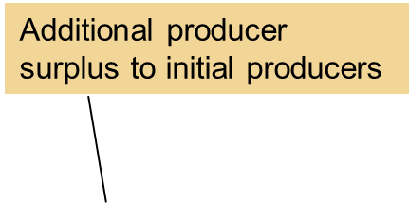
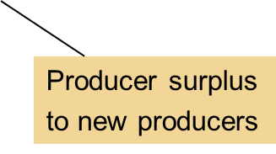
Figure 6
How Price Affects Producer Surplus
(a) Producer Surplus At Price P₁
(b) Producer Surplus At Price P₂
Price
Price
Supply
Supply
D
E
F
P₂
B
B
P₁
P₁
C
C
Initial
producer
surplus
Producer
surplus
A
A
0
Q₁
Quantity
0
Q₁
Q₂
Quantity
In panel (a), the price is P₁, the quantity supplied is Q₁, and producer surplus equals the area of the triangle ABC. When the price rises from P₁ to P₂, as in panel (b), the quantity supplied rises from Q₁ to Q₂, and the producer surplus rises to the area of the triangle ADF. The increase in producer surplus (area BCFD) occurs in part because existing producers now receive more (area BCED) and in part because new producers enter the market at the higher price (area CEF).
© 2015 Cengage Learning. All Rights Reserved. May not be copied, scanned, or duplicated, in whole or in part, except for use as permitted in a license distributed with a certain product or service or otherwise on a password-protected website for classroom use.

Slide 20
Market Efficiency
The benevolent social planner
  All-knowing, all-powerful, well-intentioned dictator
  Wants to maximize the economic well-being of everyone in society
Economic well-being of a society
  Total surplus
  Sum of consumer and producer surplus
© 2015 Cengage Learning. All Rights Reserved. May not be copied, scanned, or duplicated, in whole or in part, except for use as permitted in a license distributed with a certain product or service or otherwise on a password-protected website for classroom use.

Slide 21
Market Efficiency
Total surplus = Consumer surplus + Producer surplus
    Consumer surplus = Value to buyers – Amount paid by buyers
    Producer surplus = Amount received by sellers – Cost to sellers
    Amount paid by buyers = Amount received by sellers
Total surplus = Value to buyers – Cost to sellers
© 2015 Cengage Learning. All Rights Reserved. May not be copied, scanned, or duplicated, in whole or in part, except for use as permitted in a license distributed with a certain product or service or otherwise on a password-protected website for classroom use.

Slide 22
Market Efficiency
Efficiency
  Property of a resource allocation
  Maximizing the total surplus received by all members of society
Equality
  Property of distributing economic prosperity uniformly among the members of society
© 2015 Cengage Learning. All Rights Reserved. May not be copied, scanned, or duplicated, in whole or in part, except for use as permitted in a license distributed with a certain product or service or otherwise on a password-protected website for classroom use.

Slide 23
Market Efficiency
Gains from trade in a market
  Like a pie to be shared among the market participants
The question of efficiency
  Whether the pie is as big as possible
The question of equality
  How the pie is sliced
  How the portions are distributed among members of society
© 2015 Cengage Learning. All Rights Reserved. May not be copied, scanned, or duplicated, in whole or in part, except for use as permitted in a license distributed with a certain product or service or otherwise on a password-protected website for classroom use.

Slide 24
Market Efficiency
Market outcomes
  Free markets allocate the supply of goods to the buyers who value them most highly
    Measured by their willingness to pay
  Free markets allocate the demand for goods to the sellers who can produce them at the least cost
© 2015 Cengage Learning. All Rights Reserved. May not be copied, scanned, or duplicated, in whole or in part, except for use as permitted in a license distributed with a certain product or service or otherwise on a password-protected website for classroom use.

Slide 25
Figure 7
Consumer and Producer Surplus in the Market Equilibrium
Price
A
Supply
D
Consumer
surplus
Equilibrium
price
E
Producer
surplus
B
Demand
C
0
Equilibrium
quantity
Quantity
Total surplus—the sum of consumer and producer surplus—is the area between the supply and demand curves up to the equilibrium quantity
© 2015 Cengage Learning. All Rights Reserved. May not be copied, scanned, or duplicated, in whole or in part, except for use as permitted in a license distributed with a certain product or service or otherwise on a password-protected website for classroom use.

Slide 26
Market Efficiency
At market equilibrium, social planner
  Cannot increase economic well-being by
    Changing the allocation of consumption among buyers
    Changing the allocation of production among sellers
  Cannot rise total economic well-being by
    Increasing or decreasing the quantity of the good
© 2015 Cengage Learning. All Rights Reserved. May not be copied, scanned, or duplicated, in whole or in part, except for use as permitted in a license distributed with a certain product or service or otherwise on a password-protected website for classroom use.

Slide 27
Market Efficiency
Market outcomes
  Free markets produce the quantity of goods that maximizes the sum of consumer and producer surplus
Market equilibrium
  Efficient allocation of resources
The benevolent social planner
  “Laissez faire” = “let people do as they will”
© 2015 Cengage Learning. All Rights Reserved. May not be copied, scanned, or duplicated, in whole or in part, except for use as permitted in a license distributed with a certain product or service or otherwise on a password-protected website for classroom use.

Slide 28
Figure 8
The Efficiency of the Equilibrium Quantity
Price
Supply
Value
to
buyers
Cost
to
sellers
Cost
to sellers
Value
to buyers
Demand
0
Q₁
Equilibrium
quantity
Q₂
Quantity
Value to buyers is greater than cost to sellers
Value to buyers is less than cost to sellers
At quantities less than the equilibrium quantity, such as Q₁, the value to buyers exceeds the cost to sellers. At quantities greater than the equilibrium quantity, such as Q₂, the cost to sellers exceeds the value to buyers. Therefore, the market equilibrium maximizes the sum of producer and consumer surplus.
© 2015 Cengage Learning. All Rights Reserved. May not be copied, scanned, or duplicated, in whole or in part, except for use as permitted in a license distributed with a certain product or service or otherwise on a password-protected website for classroom use.

Slide 29
Market Efficiency
Adam Smith’s invisible hand
  Takes all the information about buyers and sellers into account
  Guides everyone in the market to the best outcome
  Economic efficiency
Free markets
  Best way to organize economic activity
© 2015 Cengage Learning. All Rights Reserved. May not be copied, scanned, or duplicated, in whole or in part, except for use as permitted in a license distributed with a certain product or service or otherwise on a password-protected website for classroom use.

Slide 30
Should there be a market in organs?
“How a mother’s love helped save two lives”
  Ms. Stevens - her son needed a kidney transplant
  The mother’s kidney was not compatible
  Donated one of her kidneys to a stranger
  Her son was moved to the top of the kidney waiting list
© 2015 Cengage Learning. All Rights Reserved. May not be copied, scanned, or duplicated, in whole or in part, except for use as permitted in a license distributed with a certain product or service or otherwise on a password-protected website for classroom use.

Slide 31
Should there be a market in organs?
Questions
  Trade a kidney for a kidney?
  Trade a kidney for an expensive, experimental cancer treatment?
  Exchange her kidney for free tuition for her son?
  Sell her kidney for cash?
© 2015 Cengage Learning. All Rights Reserved. May not be copied, scanned, or duplicated, in whole or in part, except for use as permitted in a license distributed with a certain product or service or otherwise on a password-protected website for classroom use.

Slide 32
Should there be a market in organs?
Current public policy
  Illegal for people to sell their organs
  Government has imposed a price ceiling of zero: shortage
Large benefits to allowing a free market in organs
  People are born with two kidneys
    Usually need only one
  Few people – no working kidney
© 2015 Cengage Learning. All Rights Reserved. May not be copied, scanned, or duplicated, in whole or in part, except for use as permitted in a license distributed with a certain product or service or otherwise on a password-protected website for classroom use.

Slide 33
Should there be a market in organs?
Current situation
  Typical patient waits several years for a kidney transplant
  Every year thousands of people die because a kidney cannot be found
© 2015 Cengage Learning. All Rights Reserved. May not be copied, scanned, or duplicated, in whole or in part, except for use as permitted in a license distributed with a certain product or service or otherwise on a password-protected website for classroom use.

Slide 34
Should there be a market in organs?
Allow for kidney market
  Balance supply and demand
    Sellers get extra cash in their pockets
    Buyers get to live
    No more shortage of kidneys
    Efficient allocation of resources
© 2015 Cengage Learning. All Rights Reserved. May not be copied, scanned, or duplicated, in whole or in part, except for use as permitted in a license distributed with a certain product or service or otherwise on a password-protected website for classroom use.

Slide 35
Should there be a market in organs?
Critics: worry about fairness
  Benefit the rich at the expense of the poor
Current system: is it fair?
  Some people have an extra kidney they don’t really need
  Others are dying to get one
© 2015 Cengage Learning. All Rights Reserved. May not be copied, scanned, or duplicated, in whole or in part, except for use as permitted in a license distributed with a certain product or service or otherwise on a password-protected website for classroom use.

Slide 36
Market Efficiency & Failure
Forces of supply and demand
  Allocate resources efficiently
Several assumptions about how markets work
  Markets are perfectly competitive
  Outcome in a market matters only to the buyers and sellers in that market
© 2015 Cengage Learning. All Rights Reserved. May not be copied, scanned, or duplicated, in whole or in part, except for use as permitted in a license distributed with a certain product or service or otherwise on a password-protected website for classroom use.

Slide 37
Market Efficiency & Failure
When these assumptions do not hold
  “Market equilibrium is efficient” may no longer be true
In the world, competition is far from perfect
  Market power
    A single buyer or seller (small group)
    Control market prices
    Markets are inefficient
© 2015 Cengage Learning. All Rights Reserved. May not be copied, scanned, or duplicated, in whole or in part, except for use as permitted in a license distributed with a certain product or service or otherwise on a password-protected website for classroom use.

Slide 38
Market Efficiency & Failure
In the world
  Decisions of buyers and sellers
    Affect people who are not participants in the market at all
      Externalities - cause welfare in a market to depend on more than just the value to the buyers and the cost to the sellers
      Inefficient equilibrium - from the standpoint of society as a whole
© 2015 Cengage Learning. All Rights Reserved. May not be copied, scanned, or duplicated, in whole or in part, except for use as permitted in a license distributed with a certain product or service or otherwise on a password-protected website for classroom use.

Slide 39
Market Efficiency & Failure
Market failure
  E.g.: market power and externalities
  The inability of some unregulated markets to allocate resources efficiently
  Public policy
    Can potentially remedy the problem and increase economic efficiency
© 2015 Cengage Learning. All Rights Reserved. May not be copied, scanned, or duplicated, in whole or in part, except for use as permitted in a license distributed with a certain product or service or otherwise on a password-protected website for classroom use.

